Slide 1
3 Unique Usability Problems
Presented by: Dipesh Tha Shrestha
Presented To: Akash Deo

Slide 2
Poor Image Quality
When you upload photo, website or application reduce the quality of your photo. If you've uploaded images to your website yet when viewing them in Preview, or in Live mode, they appear blurry it is likely to be due to a combination of the original picture quality and the size of the crop you have set i.e. the smaller you make the crop the more blurry the image, but higher resolution images can cope better with this

Slide 3
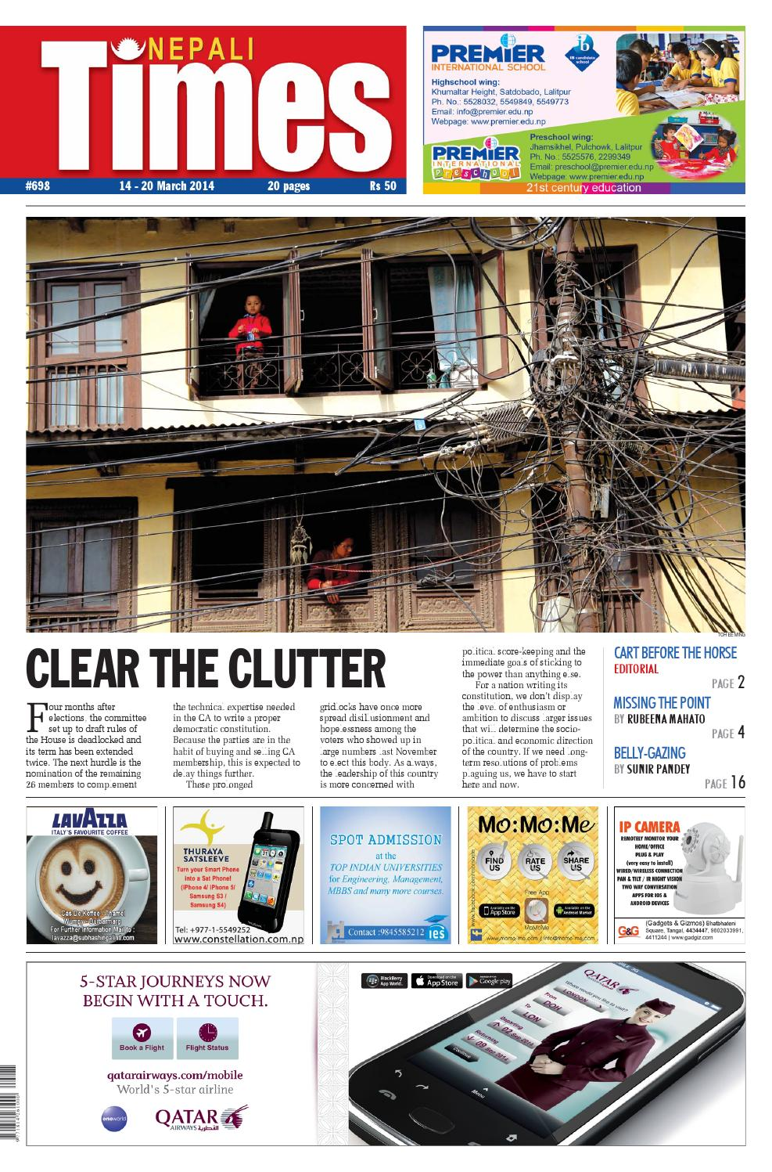
Clutter
This is a common trap for so many businesses. You might have started with a simple main message and a couple of tidy banners; three years later you have a dozen different windows all wrestling for space and attention. This can be a headache for the user and could easily detract from your main message.

Slide 4
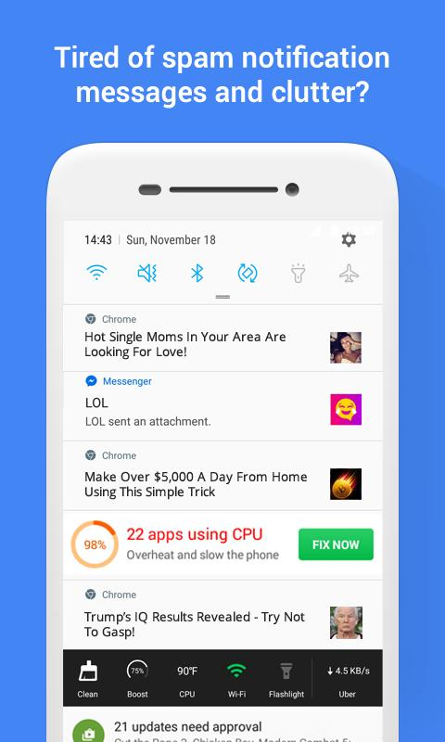
Unwanted recommendation
As the internet connect, Unwanted recommendation and news pop up in notification bar from UC browsers, vidmate and others application

